Slide 1



OSS DB Architectures
lego Blocks for OLTP, OLAP and Realtime DBs

Slide 2

Speaker : Shivji Kumar Jha (Shiv)
Regular Software Developer
Loves Open-Source Distributed Data Systems!
Working on Databases & Streaming over a decade
Heads “CPaaS Data Platform” Team at Nutanix.
Previously,
MySQL Replication, Backend microservice, Data Platform
Contributed to MySQL and Pulsar codebases among others.
Regular Speaker at meetups / conferences. 3rd talk at OSI
Organizes Oss Data community Meetups in Bangalore.
Apache Pulsar (2 meetups), Apache Druid (1 meetup) Yet…

Slide 3
Database Architecture
TRANSPORT
CLIENT COMMUNICATION
CLUSTER COMMUNICATION

Slide 4
Database Architecture
TRANSPORT
CLIENT COMMUNICATION
CLUSTER COMMUNICATION
QUERY PROCESSOR
QUERY PARSER
QUERY OPTIMIZER

Slide 5
Database Architecture
TRANSPORT
CLIENT COMMUNICATION
CLUSTER COMMUNICATION
QUERY PROCESSOR
QUERY PARSER
QUERY OPTIMIZER
EXECUTION ENGINE
REMOTE EXECUTION
LOCAL EXECUTION

Slide 6
Database Architecture
TRANSPORT
CLIENT COMMUNICATION
CLUSTER COMMUNICATION
QUERY PROCESSOR
QUERY PARSER
QUERY OPTIMIZER
EXECUTION ENGINE
REMOTE EXECUTION
LOCAL EXECUTION
STORAGE ENGINE
TRANSACTION MANAGER
LOCK MANAGER
ACCESS METHODS
BUFFER MANAGER
RECOVERY MANAGER

Slide 7
Database Architecture
TRANSPORT
CLIENT COMMUNICATION
CLUSTER COMMUNICATION
QUERY PROCESSOR
QUERY PARSER
QUERY OPTIMIZER
EXECUTION ENGINE
REMOTE EXECUTION
LOCAL EXECUTION
STORAGE ENGINE
TRANSACTION MANAGER
LOCK MANAGER
ACCESS METHODS
BUFFER MANAGER
RECOVERY MANAGER

Slide 8
QUERY LANGUAGE
TRANSPORT
CLIENT COMMUNICATION
CLUSTER COMMUNICATION

Slide 9








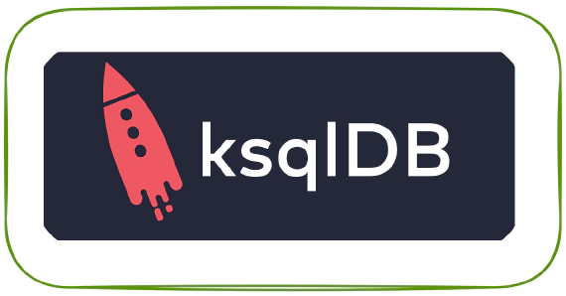
SQL
Most adopted query language
Based on relational model
Data organized into relations (tables)
Each piece of data is a tuple (row)
SQL has found usage across non-relational databases too!
STRUCTURED QUERY LANGUAGE
Relational DBs (OLTP)
Streaming
Analytics DBs (OLAP)

Slide 10
NoSQL
several driving forces:
need for greater scalability:
than relational databases can easily achieve,
very large datasets or
very high write throughput
Specialized query operations
not well supported by relational model
More dynamic & Expressive data models
restrictiveness of relational schemas
Unfortunate name
First Used for a hashtag before a meetup on non-relational Databases in 2009.
Not only SQL

Slide 11
NoSQL
Variety of databases:
Not only SQL

Slide 12

NoSQL
Variety of databases:
Document databases
Not only SQL
Document DB

Slide 13

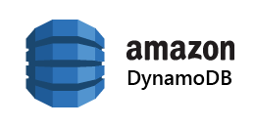
NoSQL
Variety of databases:
Document databases
Key value databases
Not only SQL
Document DB
Key Value DB

Slide 14


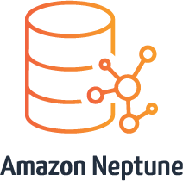
NoSQL
Variety of databases:
Document databases
Key value databases
Graph databases
Not only SQL
Document DB
Key Value DB
Graph DBs

Slide 15
NoSQL
Variety of databases:
Document databases
Key value databases
Graph databases
Column oriented databases
Not only SQL
Document DB
Key Value DB
Graph DBs
Columnar DBs

Slide 16









Wide Column DBs
Vector DBs
Distributed SQL DBs
PgVector

Slide 17
Wide Column DBs
Vector DBs
https://dbdb.io/
Distributed SQL DBs
PgVector

Slide 18
Data model & Query Patterns
TRANSPORT
CLIENT COMMUNICATION
CLUSTER COMMUNICATION

Slide 19
Oltp vs OLAP characterics
Property | Transaction processing systems (OLTP) | Analytic systems (OLAP)
Main read pattern | Small number of records per query, fetched by key | Aggregate over large number of records
Main write pattern | Random-access, low-latency writes from user input | Bulk import (ETL) or event stream
Primarily used by | End user/customer, via web application | Internal analyst, for decision support
What data represents | Latest state of data (current point in time) | History of events that happened over time
Datasize size | Gigabytes to terabytes | Terabytes to petabytes

Slide 20
Cluster communication
TRANSPORT
CLIENT COMMUNICATION
CLUSTER COMMUNICATION
EXECUTION ENGINE
REMOTE EXECUTION
LOCAL EXECUTION

Slide 21
CAP Theorem
a shared-data system can have at most two of the three following properties: Consistency, Availability, and tolerance to network partitions
CONSISTENCY
AVAILABILITY
PARITION TOLERANCE
-- Dr. Eric Brewer (2000)

Slide 22
CAP Consistency (Linearizable)
Consistency in CAP actually means linearizability, which is a very specific (and very strong) notion of consistency. nothing to do with the C in ACID, even though that C also stands for “consistency.
if you want to provide linearizable semantics (CAP-consistency) in your database, you need to make it appear as though there is only a single copy of the data, even though there may be copies (replicas, caches) of the data in multiple places.
-- Martin klepmann

Slide 23
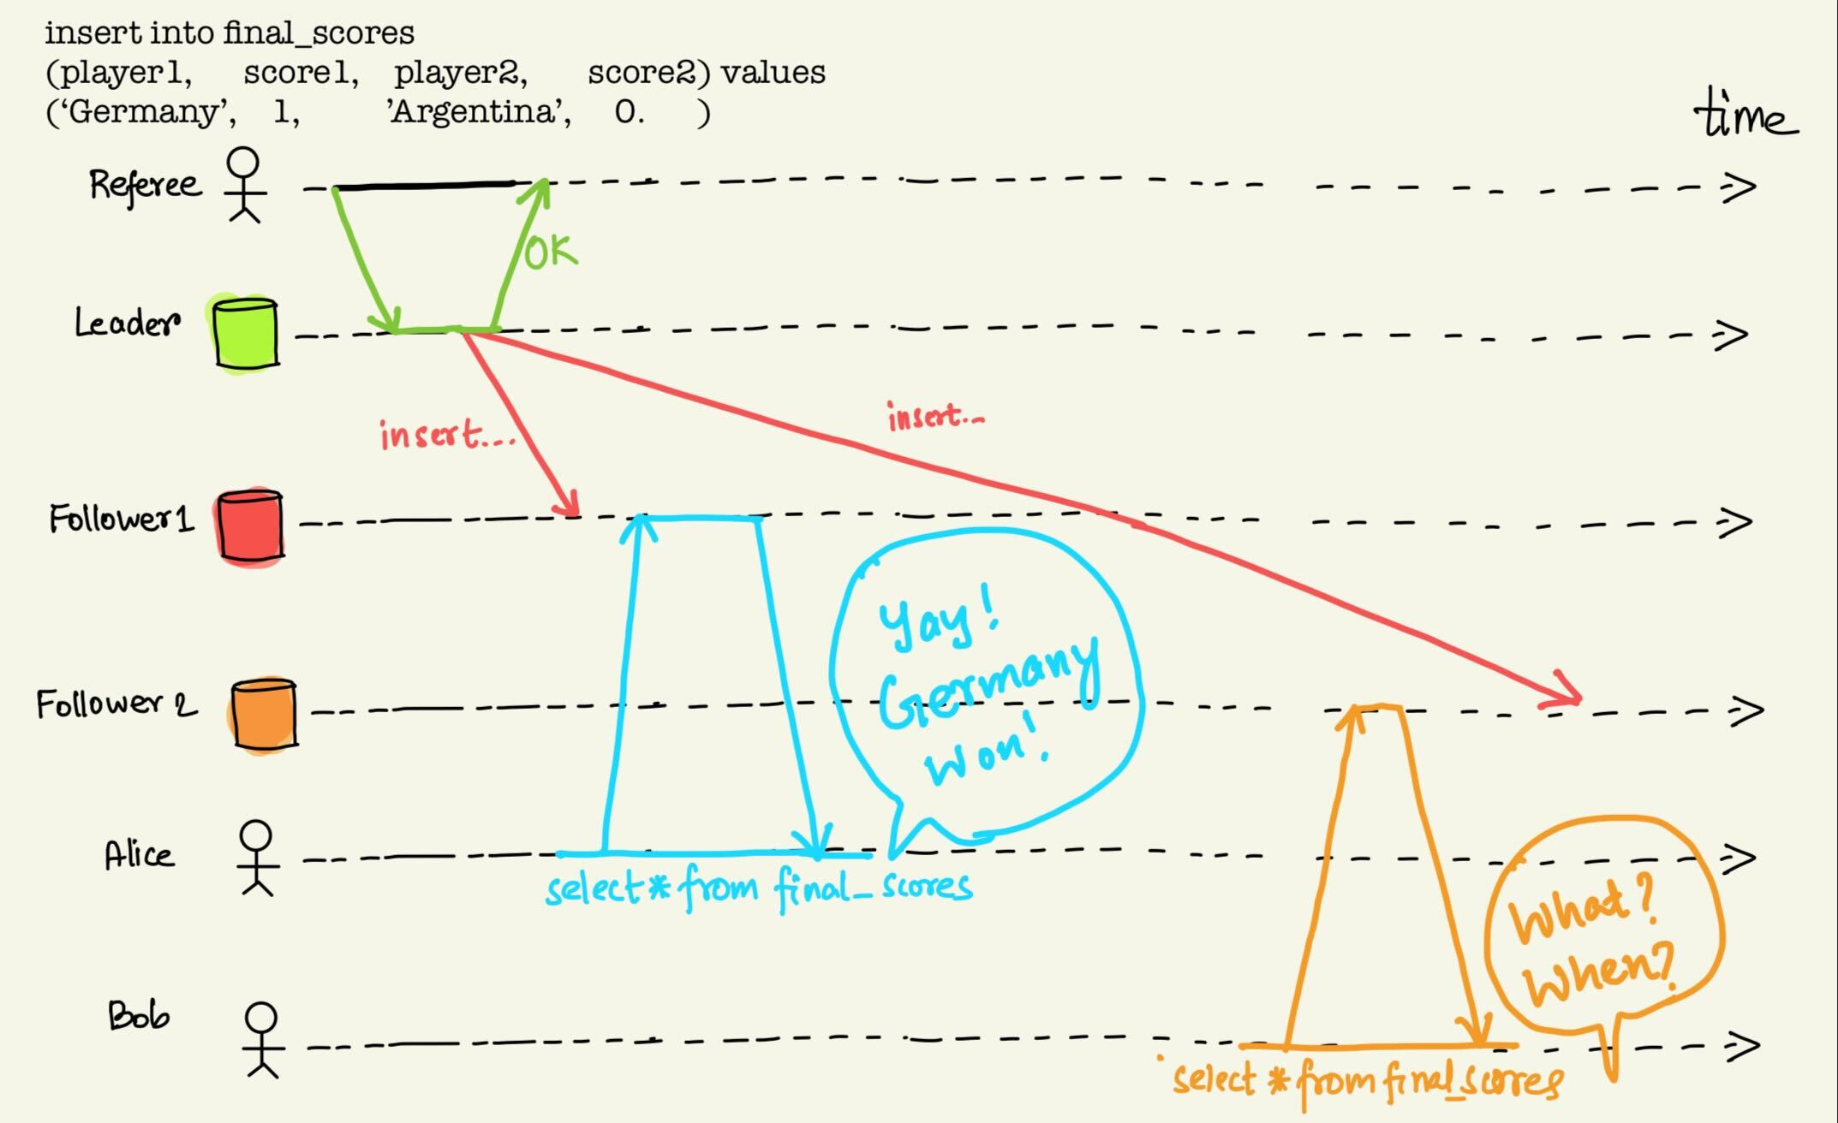
CAP- Consistency (Linearizable)
MySQL / PostgreSQL

Slide 24


CAP- Consistency (Linearizable)
Not CAP consistent

Slide 25
CAP - AVAILABILITY
Availability in CAP is defined as “every request received by a non-failing [database] node in the system must result in a [non-error] response”. It’s not sufficient for some node to be able to handle the request: any non-failing node needs to be able to handle it
-- Martin klepmann

Slide 26
CAP - Partition tolerance
Partition Tolerance (terribly mis-named) basically means that you’re communicating over an asynchronous network that may delay or drop messages. The internet and all our datacenters have this property, you don’t really have any choice in this matter.
-- Martin klepmann

Slide 27

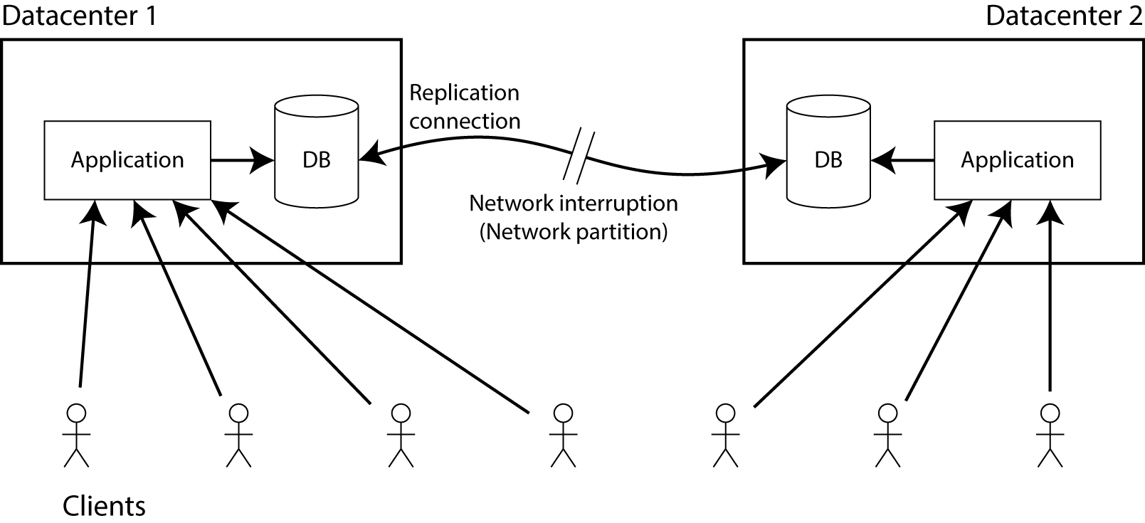

CAP : When network breaks
Alice
Bob
-- Martin klepmann

Slide 28
CAP : while network down (in-practice…)
Violate linearizability (AP?)
Violate cap-availability (CP?)
The application continues to be allowed to write to the database, so it remains fully available in both datacentres.
any changes that are written in one datacentre will not appear in the other datacentre
make sure you do all your reads and writes in one datacentre, which you may call the leader.
In other datacentre, stop accepting reads and writes until the network partition is healed and the database is in sync again. Non-failing must return response.
-- Martin klepmann

Slide 29
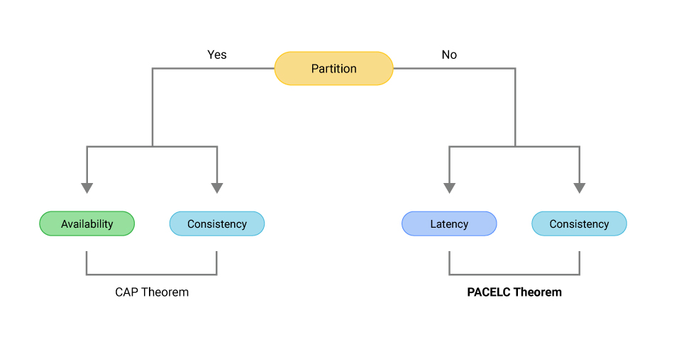
CAP – Pac(e)lc theorem
-- Prof Daniel Abadi
Pic Credits: https://www.scylladb.com/glossary/pacelc-theorem

Slide 30
REPLICATION
Why?
Low latency
Keep data close to user’s GEO
Increased availability
Up even if some parts of system fail
More throughput
More number of machines serve queries
MULTIPLE COPIES OF DATA

Slide 31
REPLICATION
Why?
Low latency
Keep data close to user’s GEO
Increased availability
Up even if some parts of system fail
More throughput
More number of machines serve queries
Leader based replication
Single leader
Multi-leader
leaderless
MULTIPLE COPIES OF DATA

Slide 32
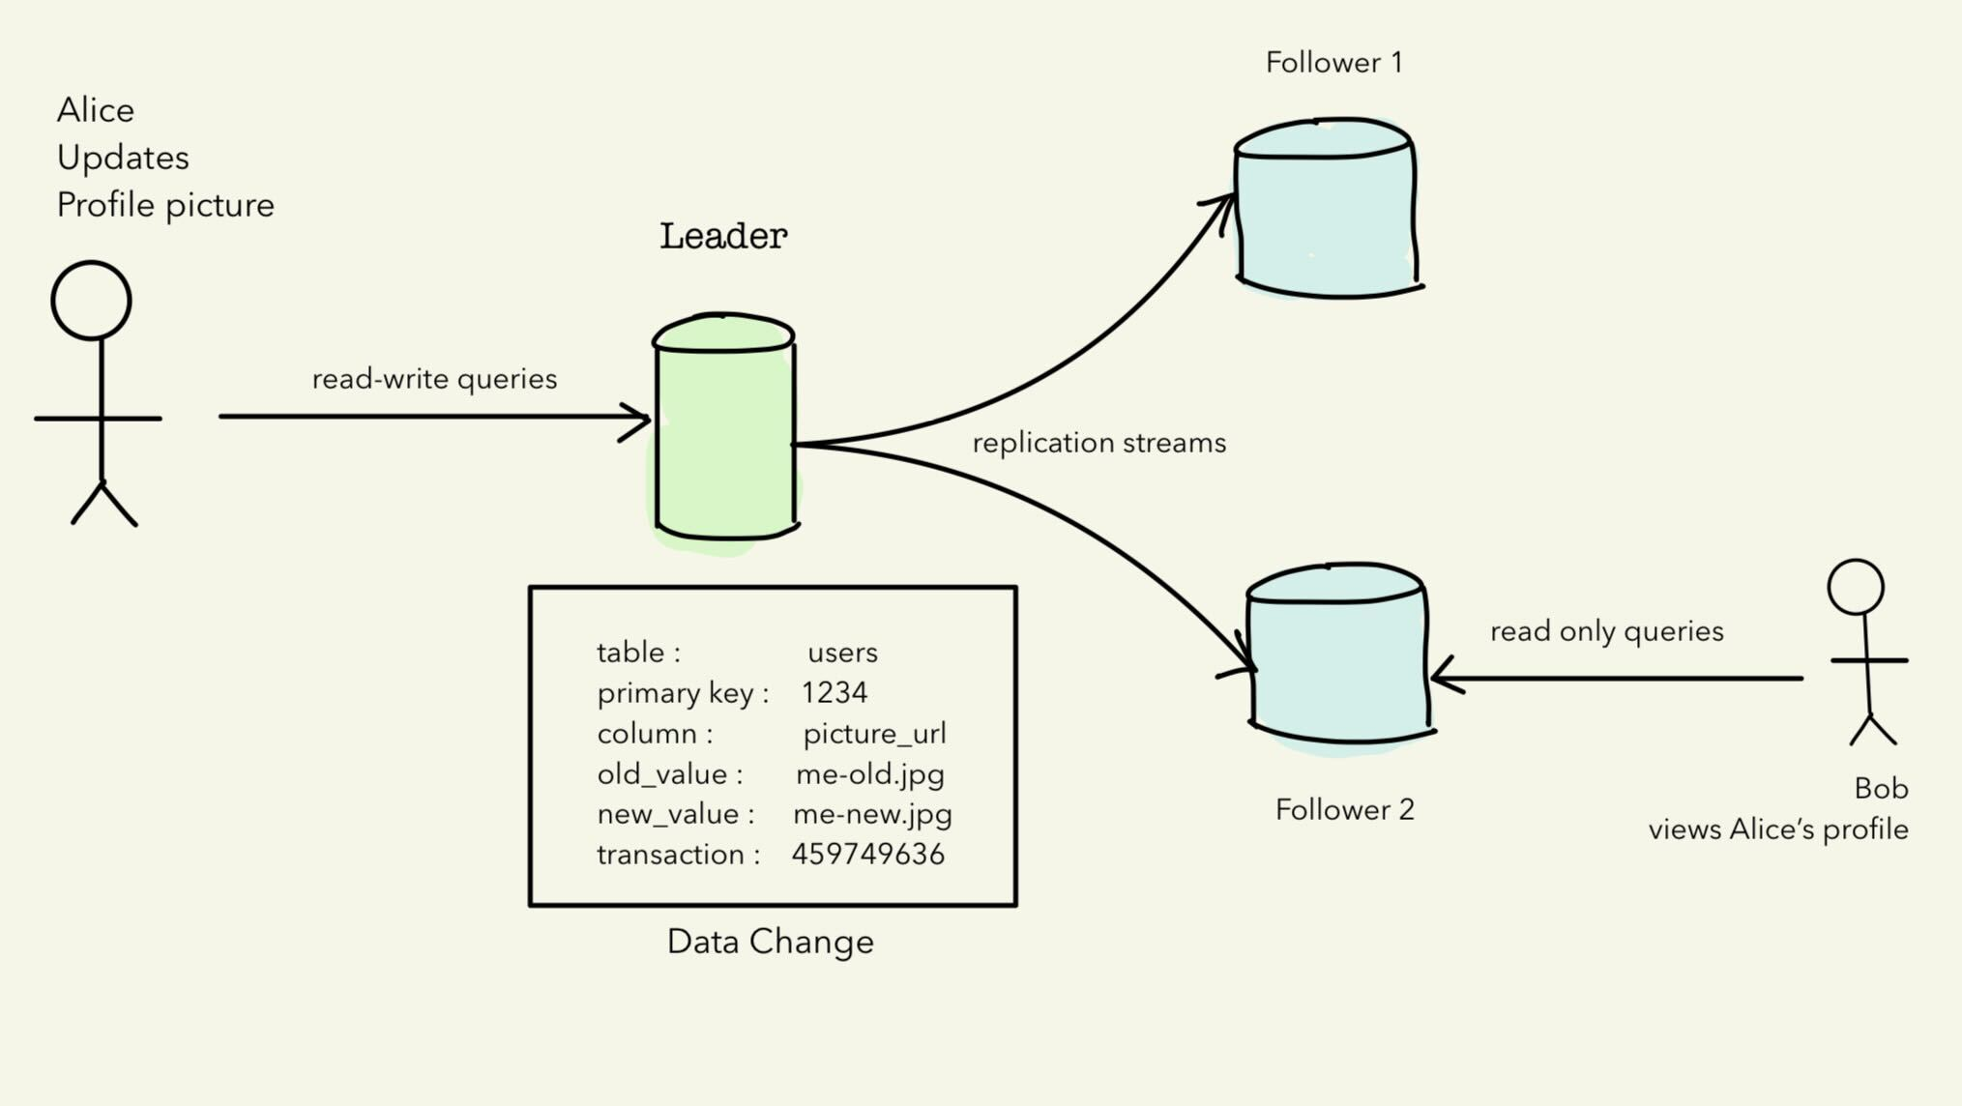
LEADER based (Leader-follower)

Slide 33
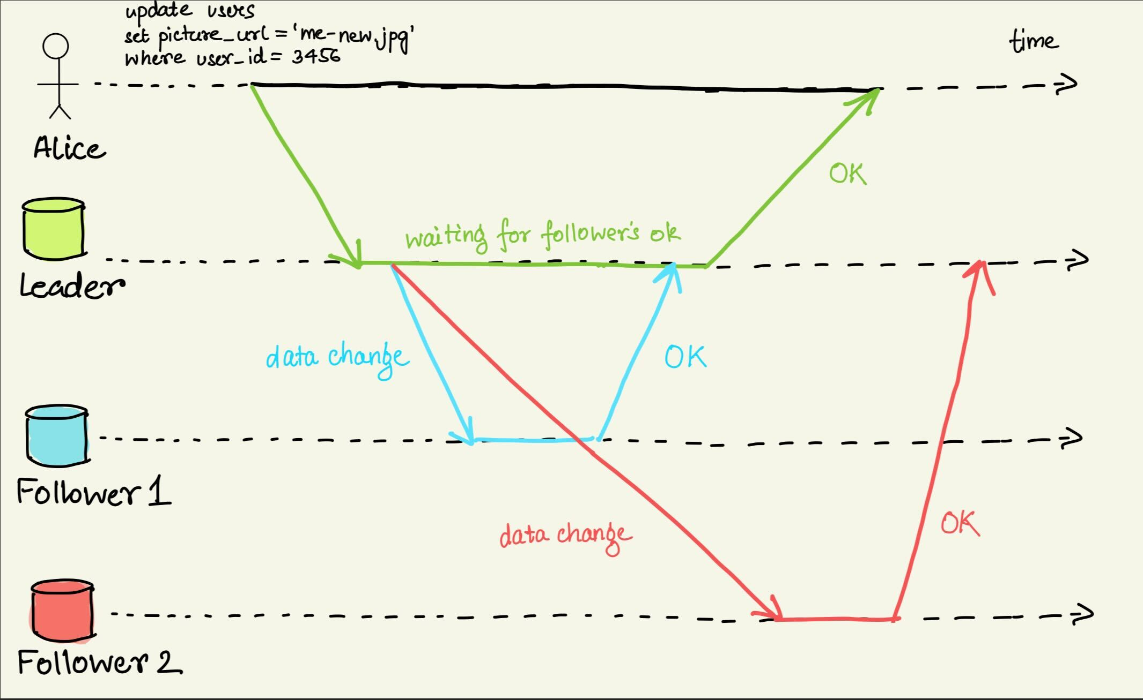
Replication Protocols (configurable?)
(A)SYNCHRONOUS
SYNCHRONOUS
SEMI-SYNCHRONOUS

Slide 34
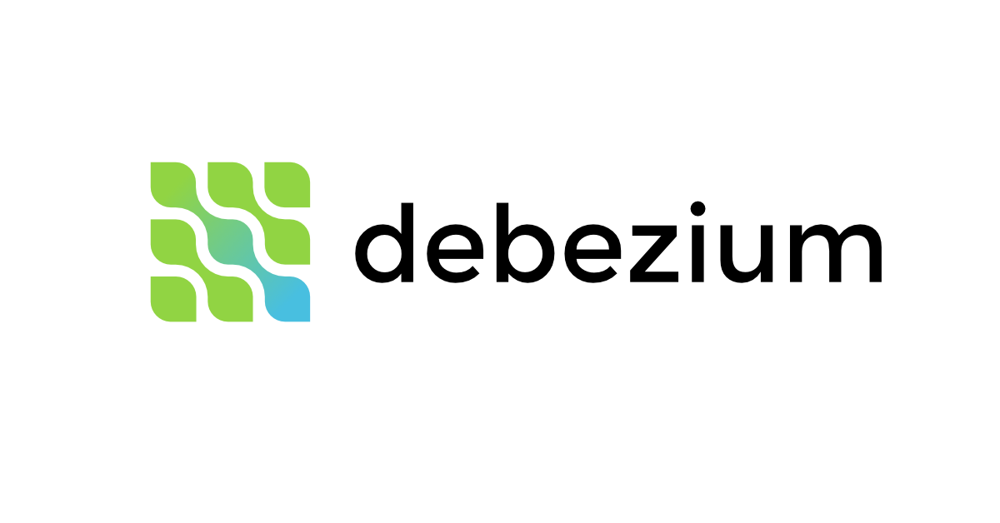

REPLICATION LOGS format
Statement based
Wal shipping
Logical (ROW-based)
Now? / RAND() ?
Autoincrement columns?
Triggers / Stored procedures / UDFs?
B-tree : WAL is source of truth
LSM: Log is main storage
MySQL Binlog’s RBR
Postgres logical Replication
Network bandwidth ?
trigger based
Move replication logic to custom code (ex: filters)
CDC : One DB to another DB
Triggers & stored Procedures

Slide 35
MULTI-LEADER replication
Typically, async replication between datacenters.
In case of failure, promote follower datacenteR
Sync replication between datacenters => latency!
Difficult / error-prone / manual conflict resolution
Couchdb designed for this. Store all versions, share with app client to resolve.
Stretched examples:
Calendar: Every client app has a database. Conflicts are common!
Collaborative apps like Google docs: make locks very small ( a single keystroke)
Partition by records (sharding)
A given record always maps to same shard.
Last write (timestamp) wins ? Numbered servers? Ask user/app to select (git)
Difficult to generalize conflict resolution in a common database

Slide 36
LEADERLESS REPLICATION (Quorum-style)
Dynamo-Db whitepaper popularized this.
Weird that dynamo-db is used ot amazon cart/checkout? Cosistency?
Cassandra, riak, Voldemort DB use this too!
Writes have to be accepted by majority.
Writes are versioned in every update.
Reads sent to majority.
Highest version accepted
Updated older version of records on lagging nodes?

Slide 37
Storage & retrieval
STORAGE ENGINE
TRANSACTION MANAGER
LOCK MANAGER
ACCESS METHODS
BUFFER MANAGER
RECOVERY MANAGER

Slide 38



Storage: data structures
B-trees
LSM-trees
Follow index to reach exact data
Optimized for fast reads
Used in SQL (relational DBs)
default data structure for index
Faster for writes
Just append, no check for duplicate.
Slower reads than b-tree
Check all versions, select last.
Better compression, Less disk.
compaction interferes with writes
Primarily used in streaming & NoSQL DBs
Rocks-DB is a very famous embeddable library

Slide 39
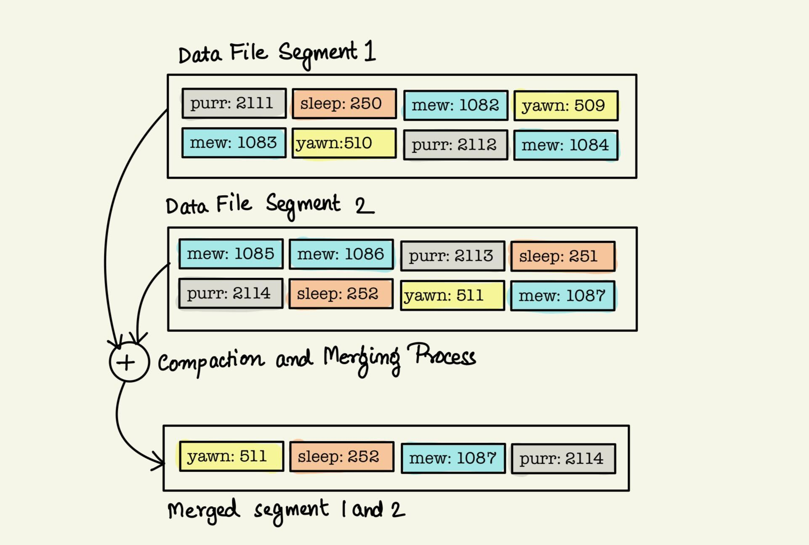
LSM- Trees:
Compacting & Merging

Slide 40
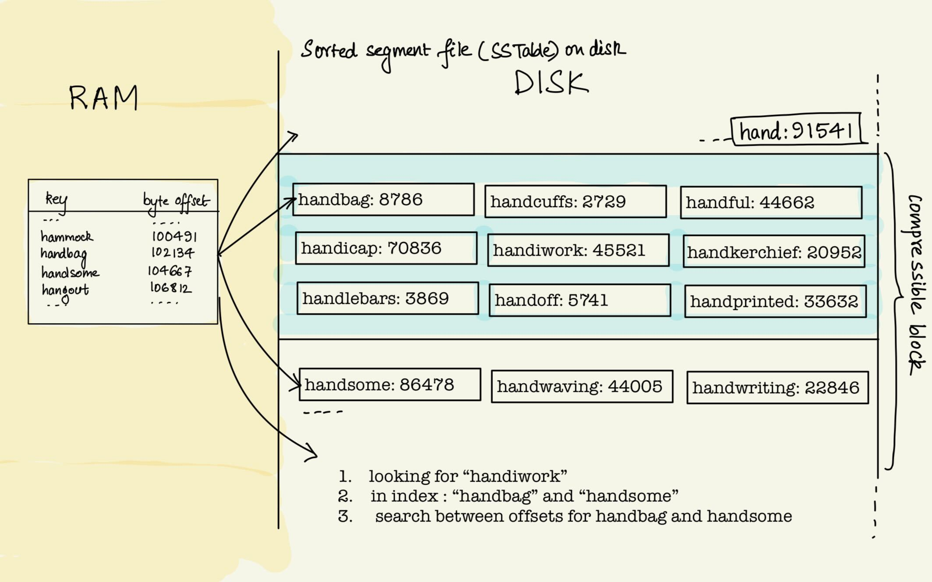
LSM- Trees:
SS-Tables with in-memory index

Slide 41
Storage: Relational (SQL) Dbs
Transaction manager :
Schedules, coordinates and tracks transactions and their individual steps.
Lock manager:
Guards access to resources
Prevents concurrent access that violates data integrity.
Transaction log flushed to WAL directly via O_direct os flag.
Buffer manager (aka Page cache)
Stages changes till persisted
Dirty pages: change in cache, not persisted to disk. Set dirty_flag.
Writes to disk in batches (durability vs throughput). Unsets dirty_flag.
Called “checkpointing” in postgresql.

Slide 42
Concurrency control (CC)
Optimistic cc (OCC) , Multi-version cc (MVCC), pessimistic CC (PCC)
MVCC
Guarantees a consistent view of db at some point in past.
Multiple timestamped versions of same rows in db.
Vacuum process cleans old ones.
When you update a row in Postgresql,
A new version of the same row is appended (new XID).
Other transactions reading that row might be using older version (say xid-1).
Once all concurrent transactions committed, xid committed. Xid-1 marked for vacuum.

Slide 43
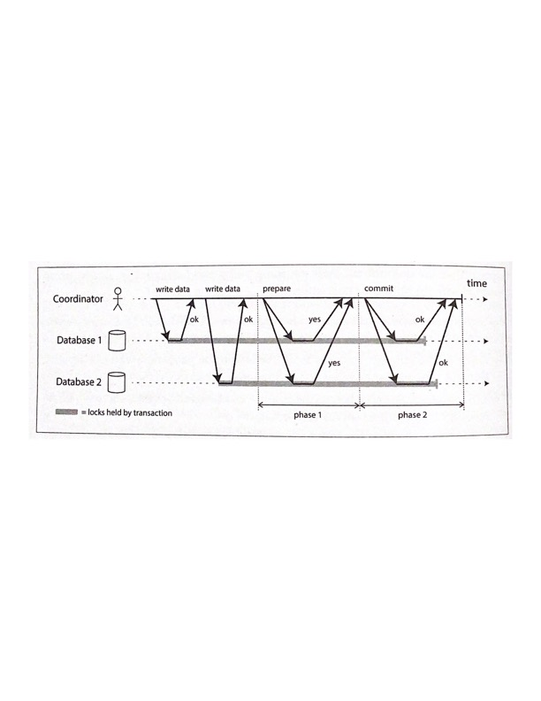
Transaction manager (2 pc)
Transaction manager uses two-phase commit (2 PC) to coordinate transaction across multiple database server nodes.

Slide 44
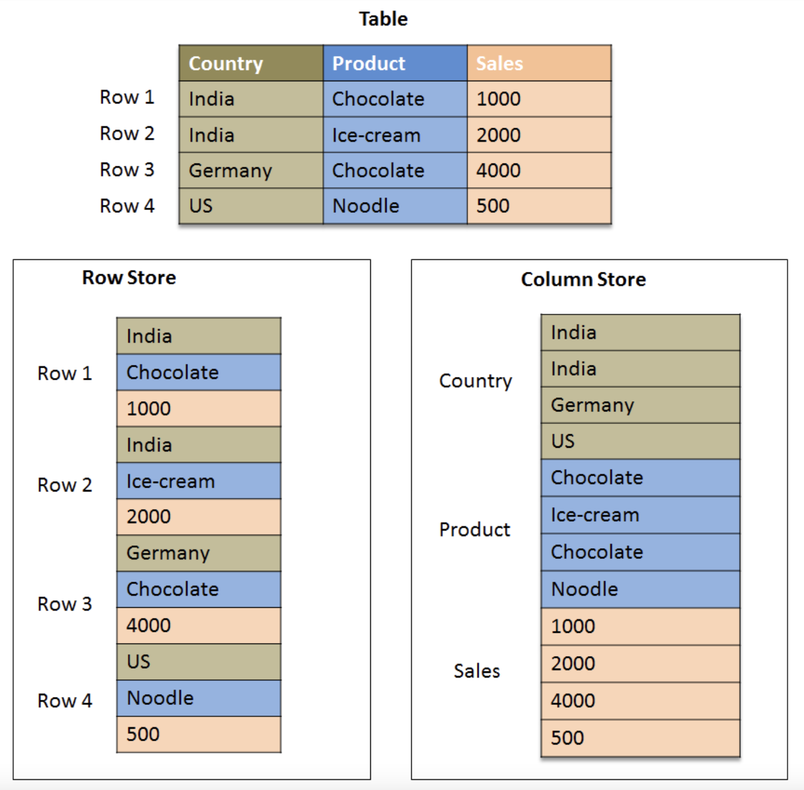
Row vs column Storage
Storing & retrieving by type of query
Note : Basic unit of disk read is a disk block
Row databases: optimize for reads by row
Column dbs for ingestion scale, pre-process data (views)

Slide 45
Some real-world Databases
Let’s see the concepts we learnt in real world!

Slide 46
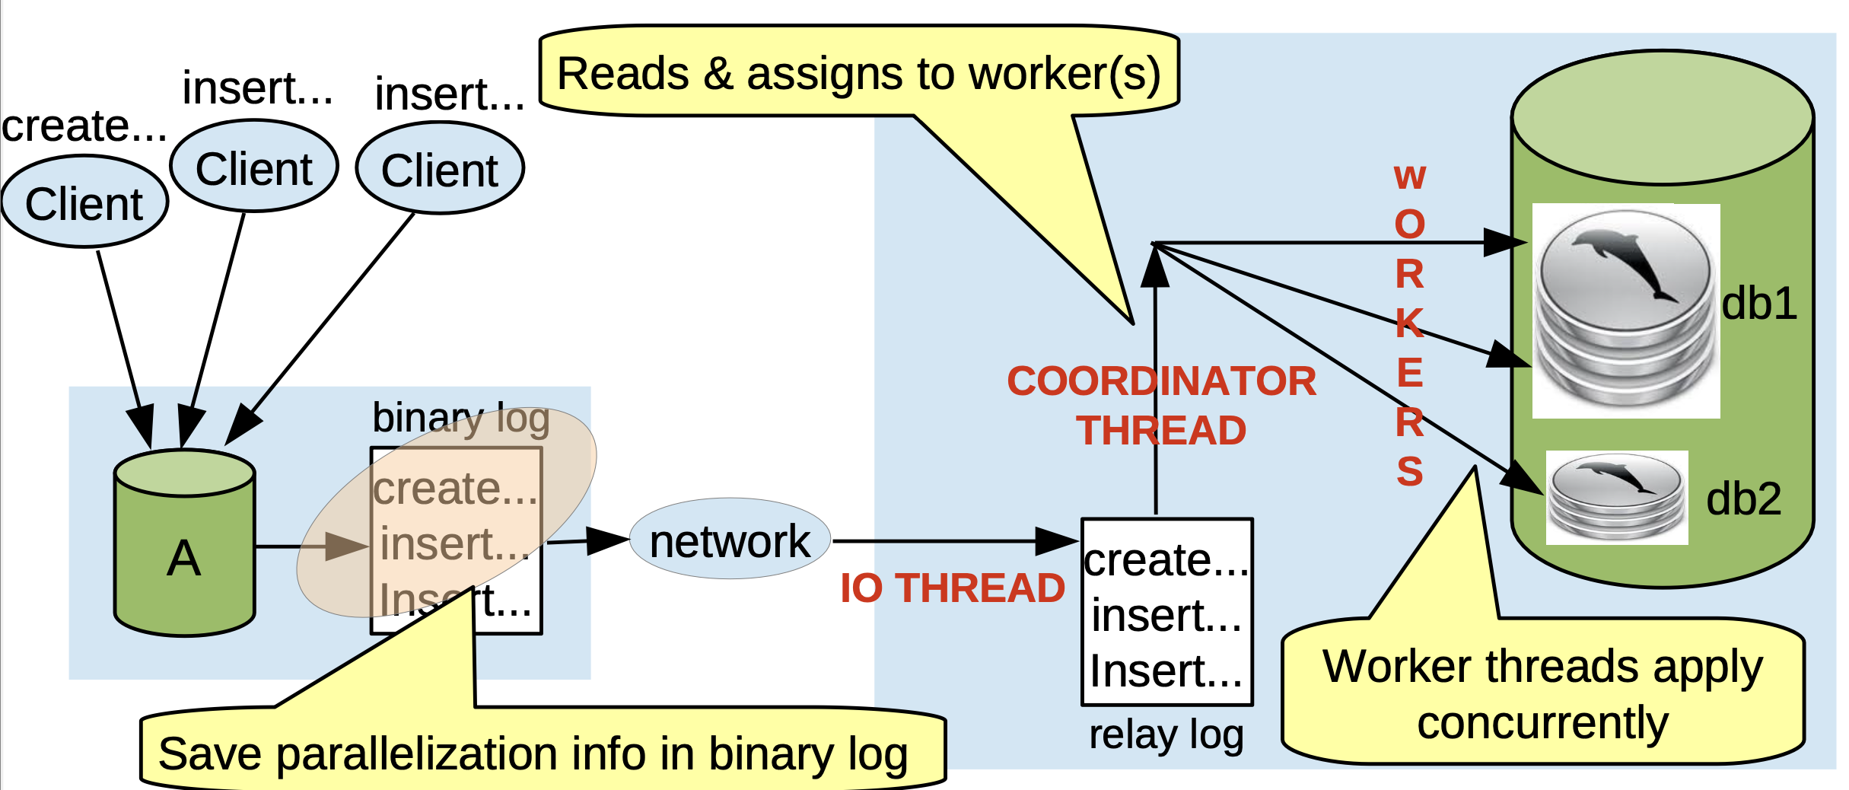
MySQL Replication Architecture

Slide 47
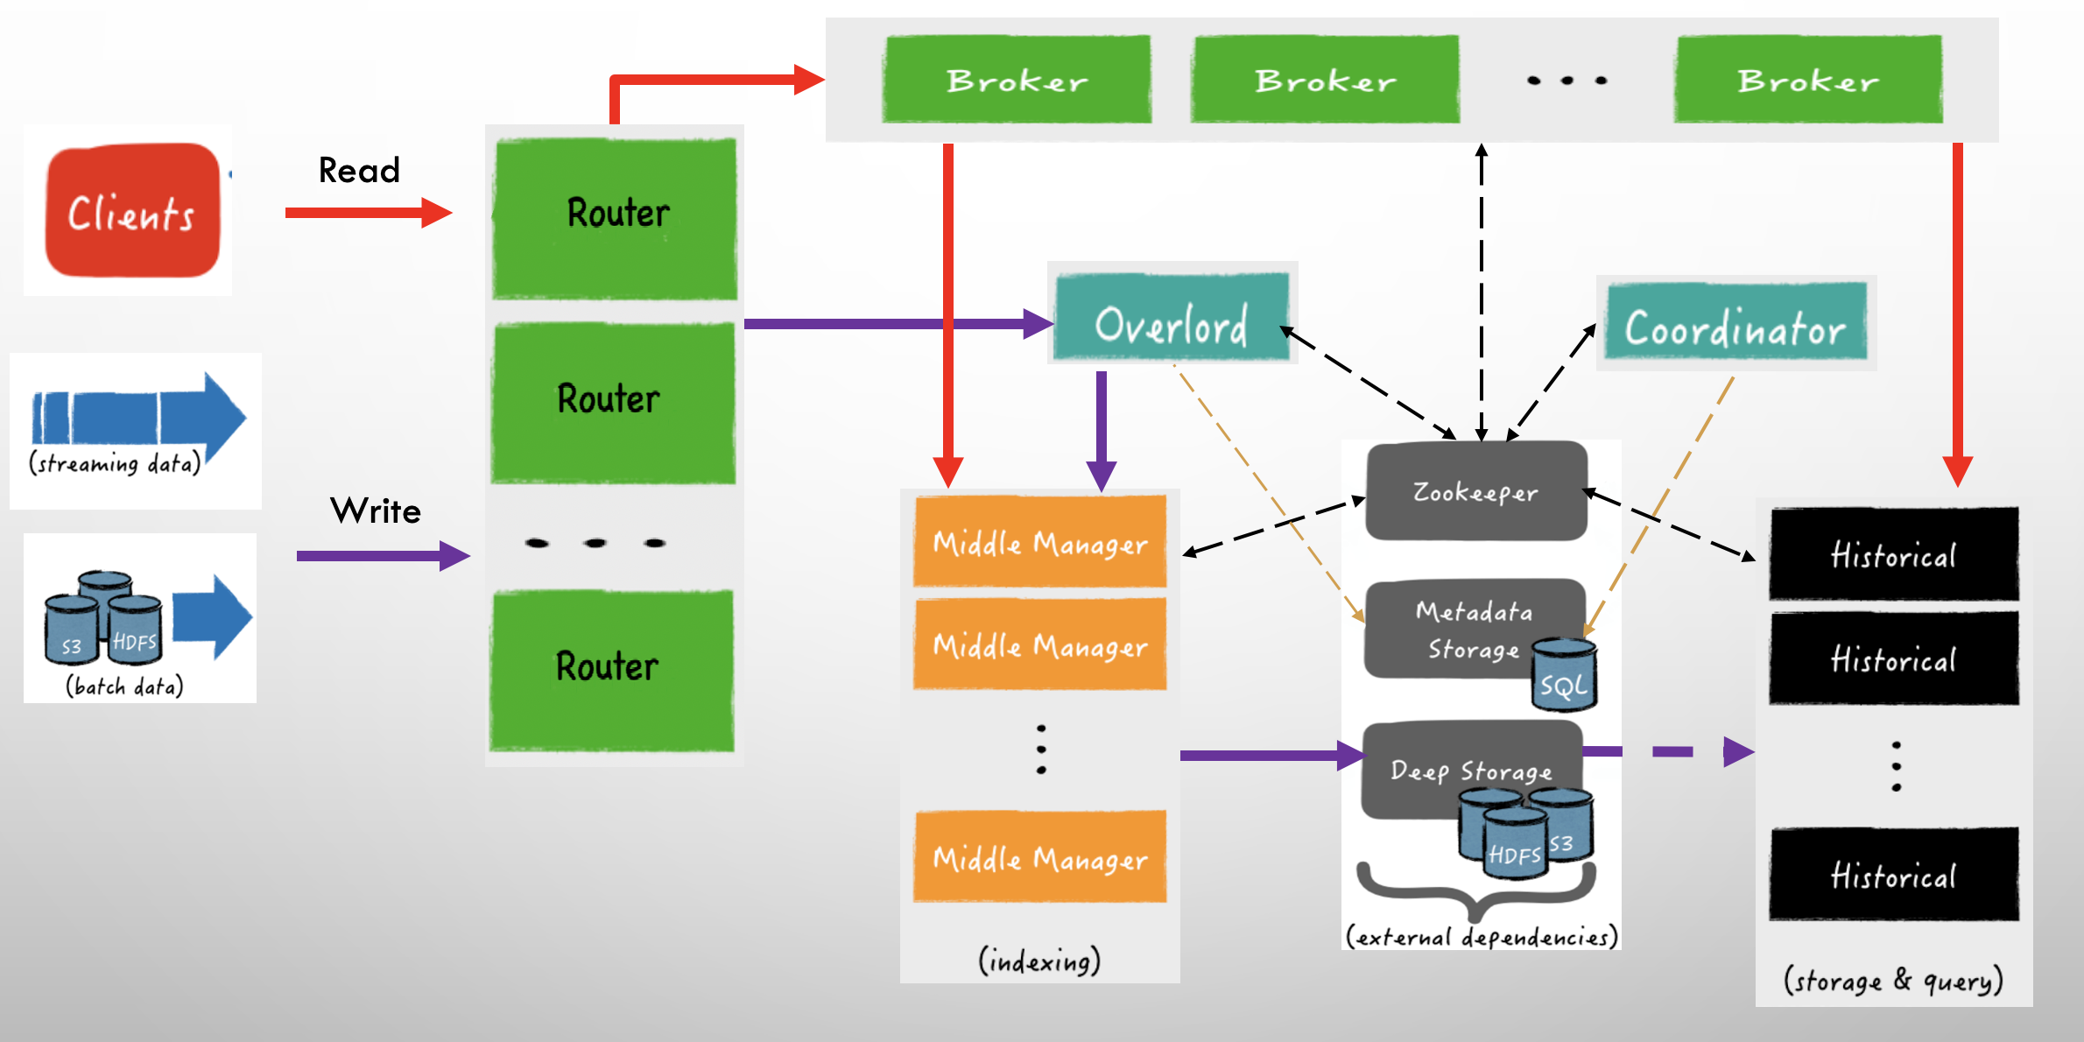
Apache Druid Architecture

Slide 48


SUBSCRIBER
Stream processing
SUBSCRIBER
TOPIC
PUBLISHER
SUBSCRIBER
Pub-sub: publish messages to subscribers
Fresh data cached for faster retrieval
Costly to retrieve old data
USE-cases: Streaming & queing

Slide 49
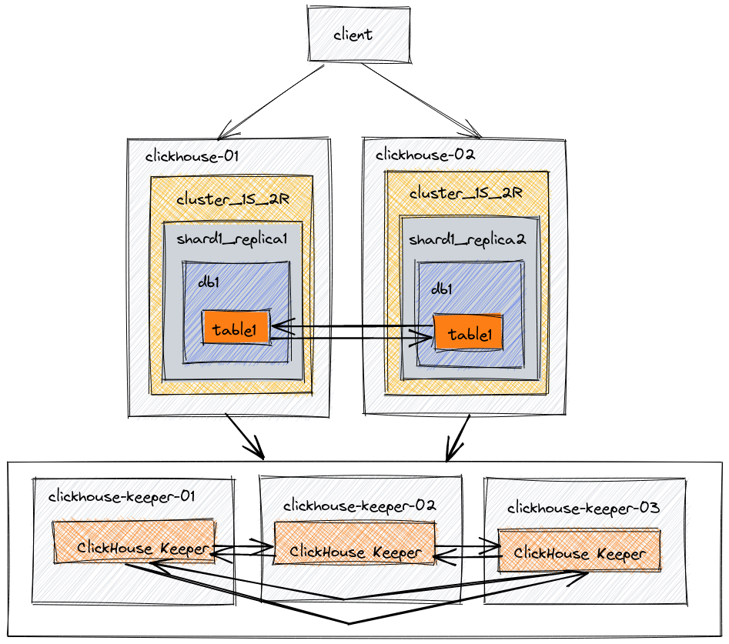
Multi-leader Databases
Clickhouse Sharding Architecture

Slide 50
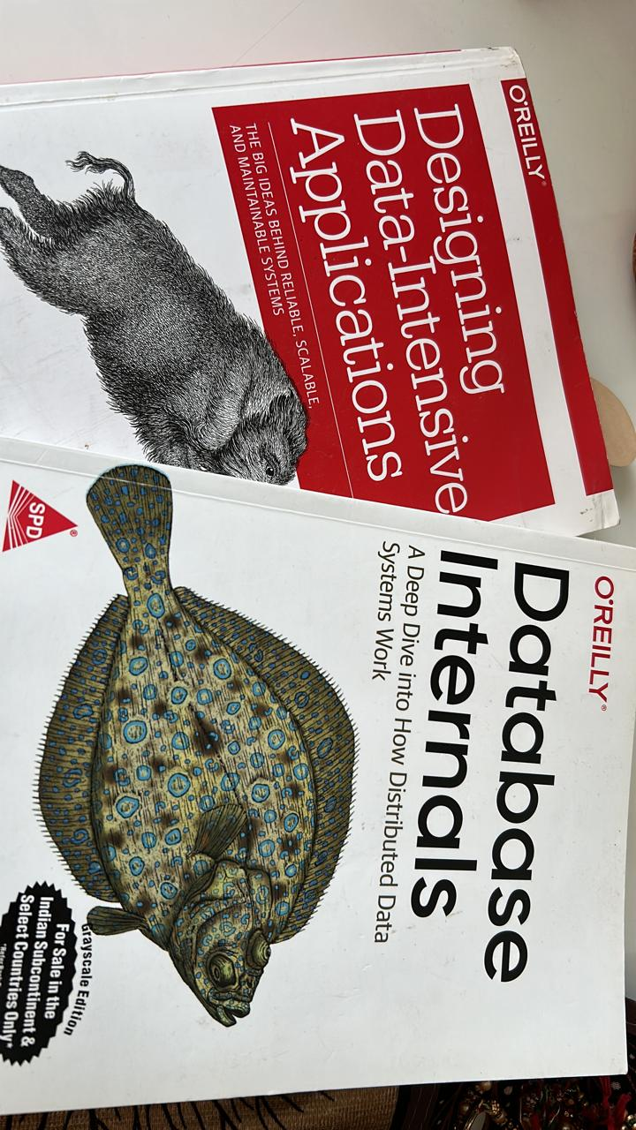
References
Books in My Drawer
Designing Data Intensive Applications -- Martin Kleppmann
Database Internals -- Alex Petrov
Blogs
Please stop calling Databases CP or AP - Martin Kleppmann
You cant sacrifice Partition Tolerance - Code Hale
Understanding How Apache Pulsar Works – Jack Vanlightly
Talks (Video Recording)
Kafka Summit ‘19: Is Kafka a Database? - Martin Kleppmann
Apache Pulsar – The anatomy of Pub & Sub – Shivji Jha (Me)
Druid Blore Meetup : Data on Kubernetes – Shivji Jha (Me) & Dinesh

Slide 51






Questions?
Bonus slides?
Drop me a message on
Contact Speaker
linkedin.com/in/shivjijha/
youtube.com/@ShivjiKumarJha
slideshare.net/shiv4289/presentations
https://t.me/+BJMxHo9RdN83MTQ1
Join “The DB Shots” on

Slide 52
Bonus slides

Slide 53
LEADER REPLICATION: node FAILURES
Catch-up on recovery
Add new replica
failover
Follower keeps log on local disk before (MySQL’s Relay Log) & after applying (MySQL’s Binlog).
Recovery as usual from binlog
Apply pending received transactions from relay log
Send “applied_transaction” to master & Ask to send rest, if any.
Write to relay log & Apply.
Take DB Snapshot
Restore on new replica
Add to cluster
Wait for sync
mark it available
Sync / async / semi-sync ?
Get the candidates to promote
Get missing transactions from other peers, if any.
Promote to master

Slide 54


Apache Pulsar Architecture
PUBLISH
CONSUME
PULSAR
BROKER (TOPIC CACHE)
BOOKKEEPER (DATA)
ZOOKEEPER (COORDINATION)

Slide 55
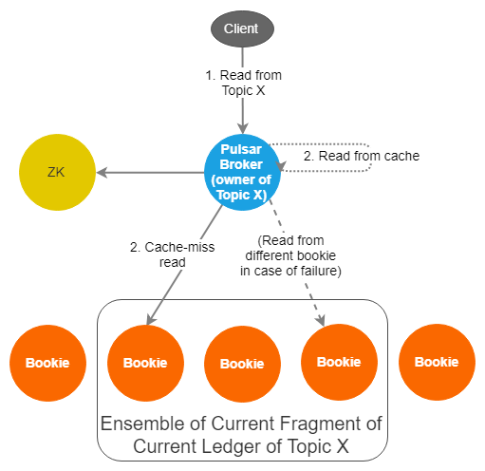
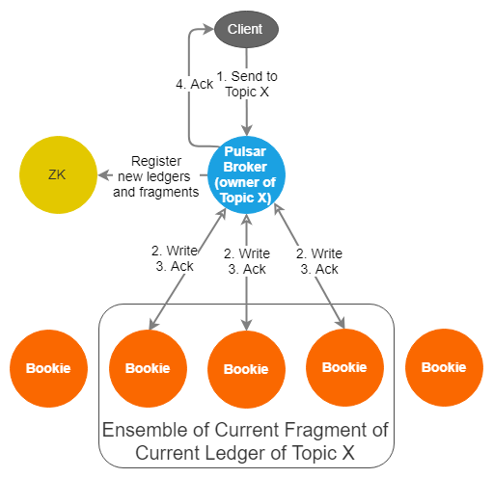
Pulsar Read Path
Pulsar Write Path

Slide 56


Inside One bookkeeper
WRITE CACHE
JOURNAL
JOURNAL
BOOKKEEPER CLIENT
LEDGER
READ CACHE
LEDGER
Legend
Synchronous write
Asynchronous Write

